Slide 1
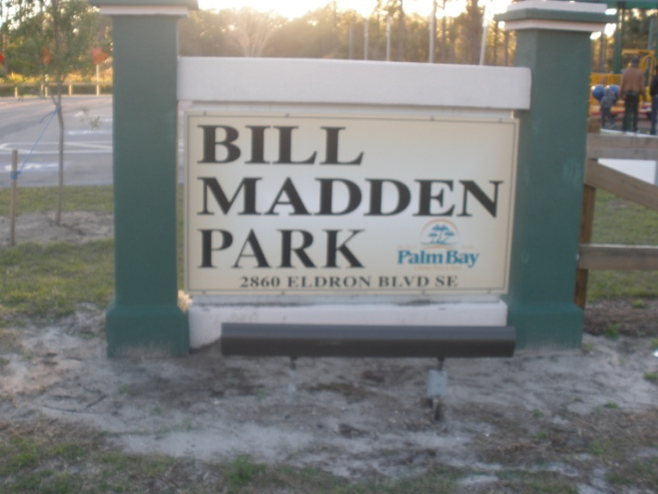
Palm bay plays
Working Together So Palm Bay Can Play!
A product of Playful City USA
March 20th City Wide Festival
Bill Madden Park
2860 Eldron Blvd. SE
Palm Bay, FL 32909

Slide 2
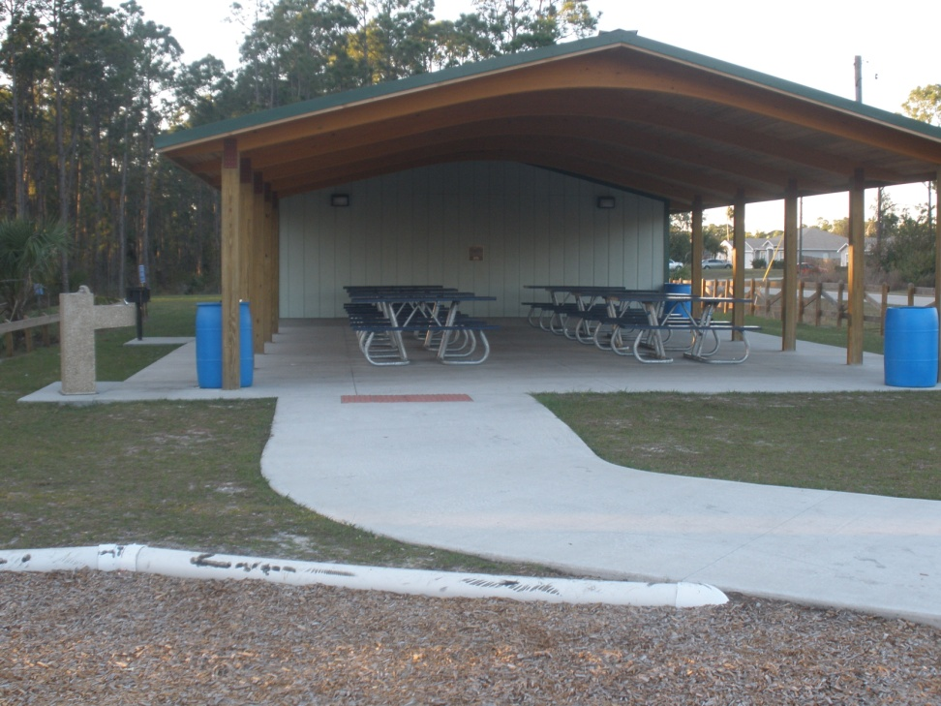
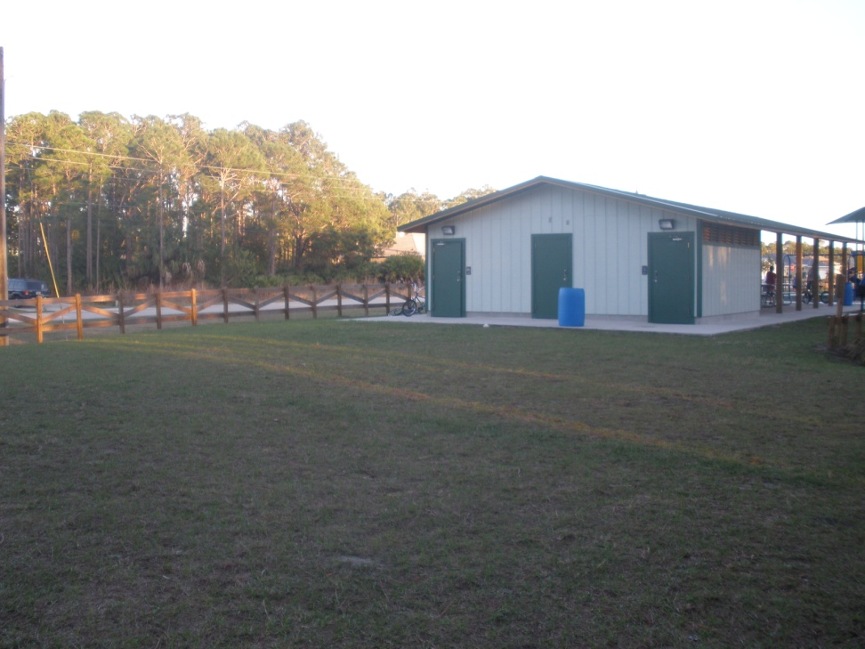
Our Park- Bill Madden Park
Pictures of our park
Dining area
The open field

Slide 3
The activities that we are planning for
Geocaching
Karate Demonstration
Canoeing
Race boat Activities
Bounce House
Dance Demonstration
Fishing Events
Play Ground Fun
Food, Water, and Soda

Slide 4
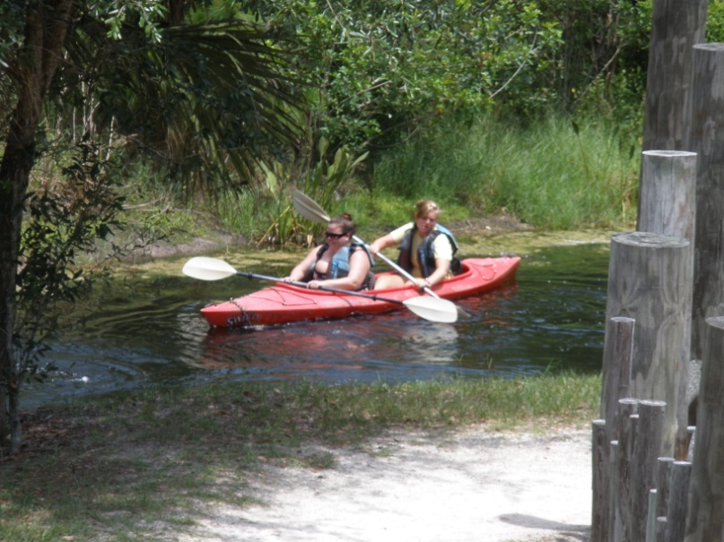
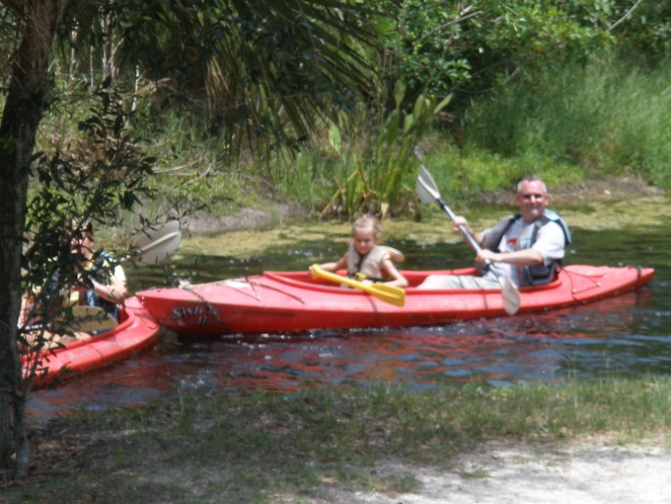
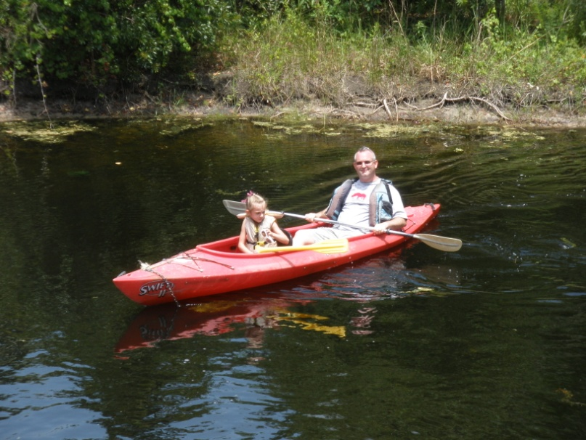
Canoeing
One of our plans is to make use of the lake in the wetlands area of the park and possibly get a canoe ride going

Slide 5
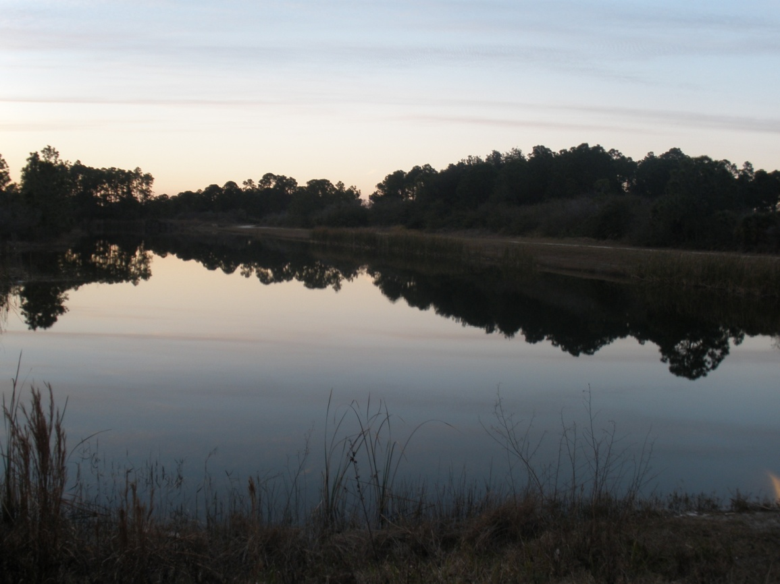
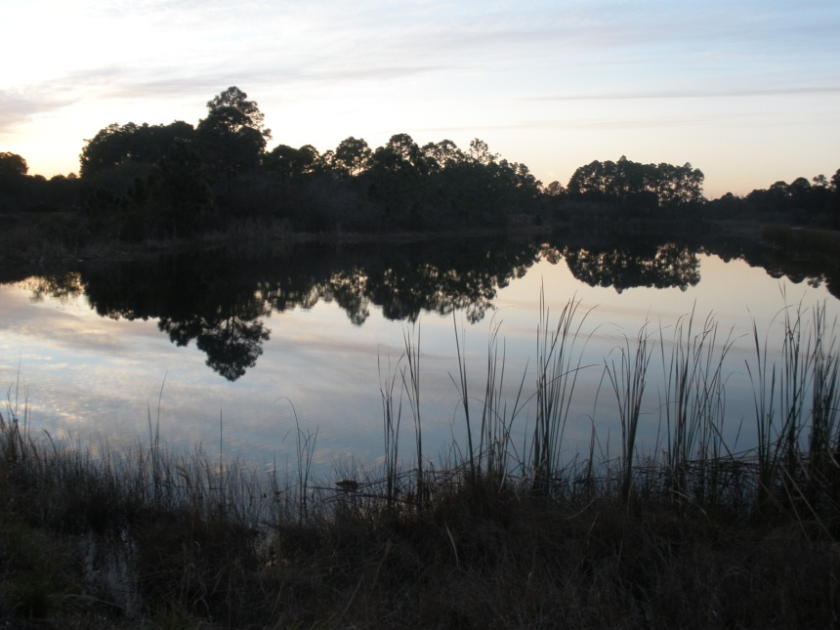
Lake for the canoeing
Nice bank on this side to fish
Different views of our lake for the water activities, fishing, canoeing, and race boats

Slide 6
Geocaching
Geocaching is an outdoor activity in which the participants use a Global Positioning System (GPS) receiver or other navigational techniques to hide and seek containers, called “geocaches” or “caches”, anywhere in the world. A typical cache is a small waterproof container (usually a Tupperware or ammo box) containing a logbook. Larger containers can also contain items for trading, usually toys or trinkets of little value. Geocaching is most often described as a “game of high-tech hide and seek”, sharing many aspect with orienteering, treasure-hunting, and way marking.

Slide 7
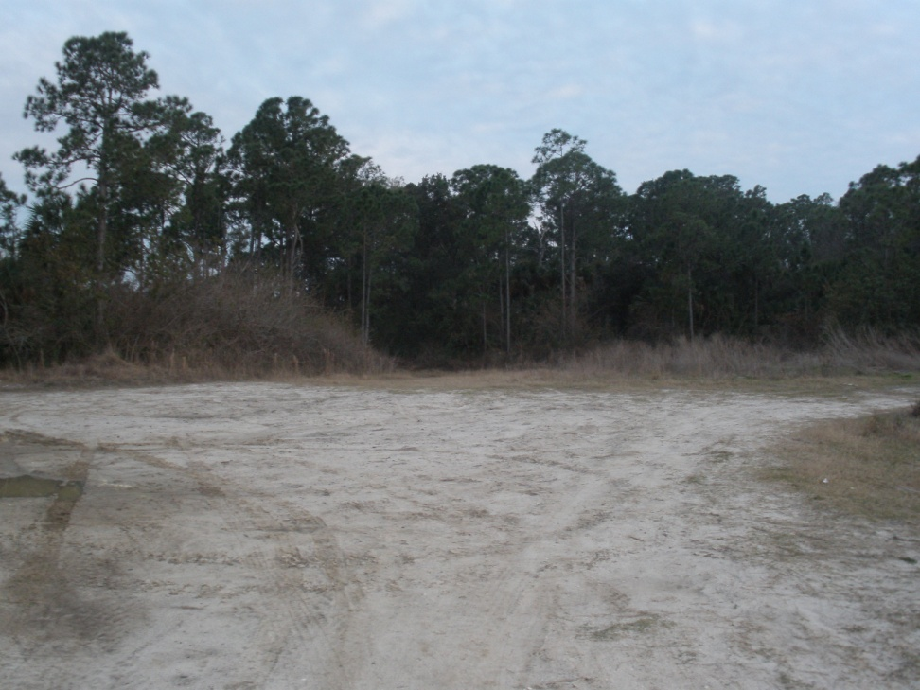
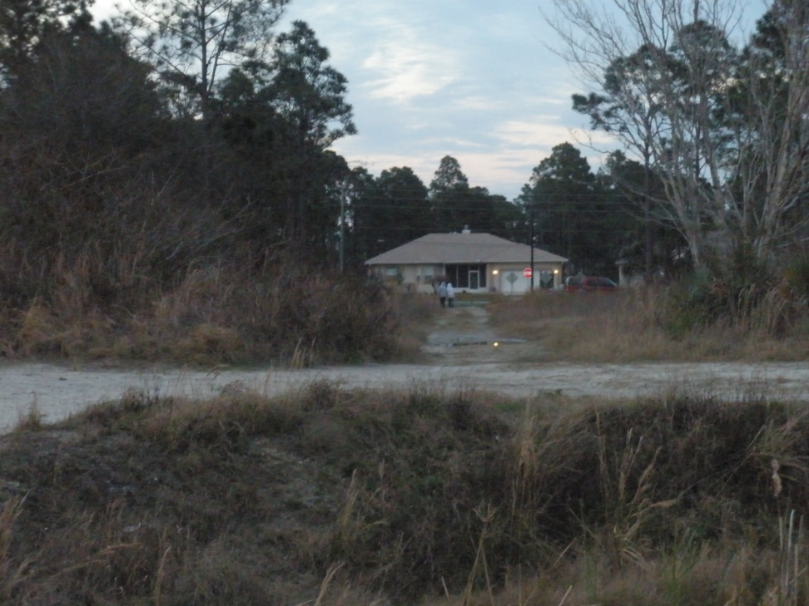
More views of the wetland area
Big open field by the lake
Path into the wetlands
Some of the area the geocaches or caches can be found

Slide 8
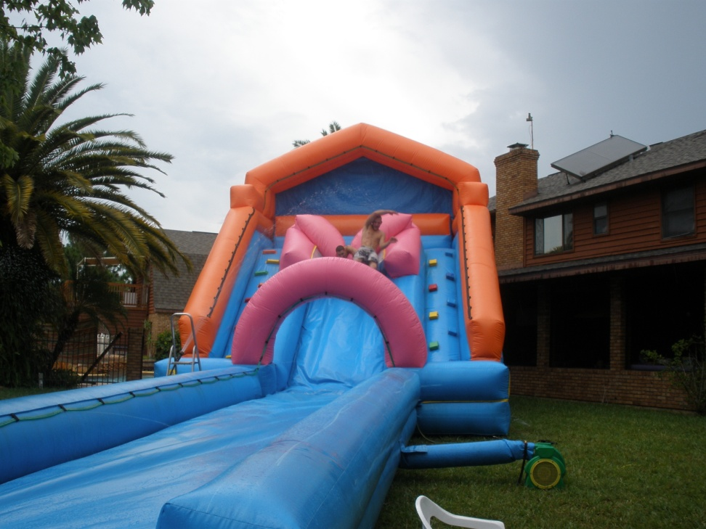
The bounce house
Area where it can go
A fun bounce house or inflatable slide can keep kids entertained when cleaning time between events are occurring or if the kids isn’t interested in the activities going on at the time
All day event
Just enough room to fit a nice size inflatable

Slide 9
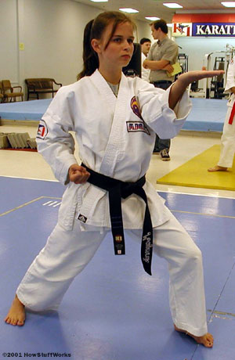
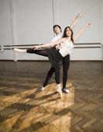
Sport Activities
Karate presentation
Dance presentation
Our plan is to get some organizations and sports teams out there that kids don’t normally consider to show them all the possibilities of the activities they can participate in

Slide 10
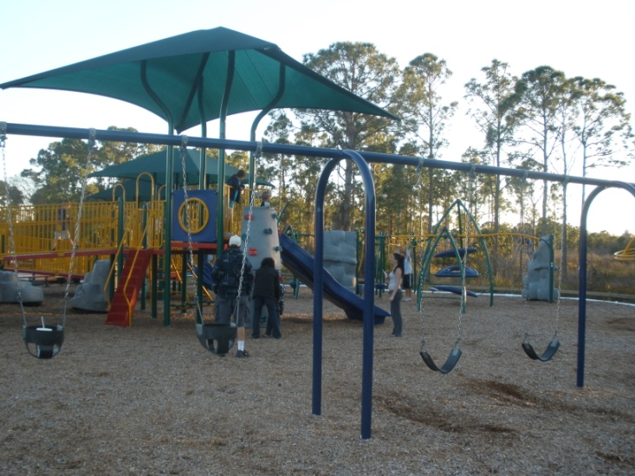
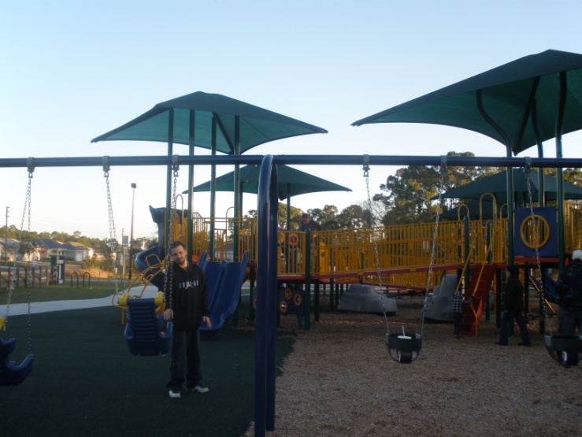
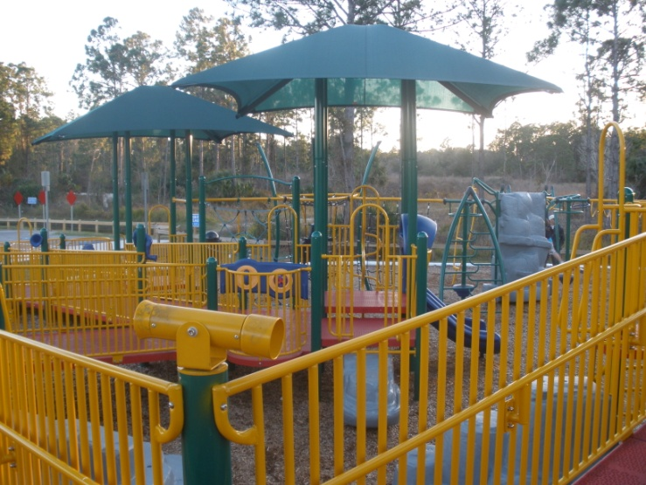
In Between Activities
Playground area 1
Playground area 2
In the mean time, while the kids are waiting for us to set up the activities, or if they are not interested in the activities, they can play on the playground; there is a lot to discover.
PLAYGROUND AREA 3

Slide 11
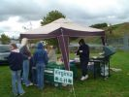
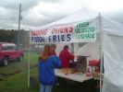
Refreshments
Our plan is to get donations from business’ to set up stands for hot dogs and water, possibly soda, and chips depending on what our budget allows for.

Slide 12
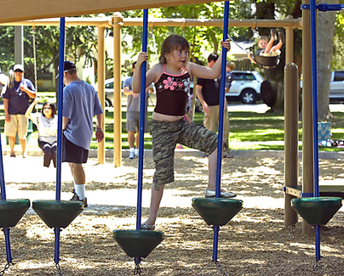
Over all Mission
To get people to have a good time
To show people all the parks there are in Palm Bay for their use
To show that there are things to do in Palm Bay more then what you would usually think of
To help the city of Palm Bay promote their “Playful City” idea
TO HAVE FUN!!!!

